Slide 1

MOHAMMAD(CSE/22/020)
RANIT KUMAR MANIK(CSE/22/034)
PARTHA SARATHI MANNA(CSE/22/04)

Slide 2









GET IT DONE
WHERE SKILL MEETS OPPURTUNITIES
Notes:
https://unsplash.com/photos/AXu2aZ3YgP8

Slide 3

OVERVIEW

Slide 4

OVERVIEW
Introducing 'Get it Done' – a revolutionary platform designed to seamlessly connect service providers with consumers, creating an accessible hub for exchanging a wide array of services. From essential trades like plumbing and electrical work to specialized services such as childcare, our platform caters to diverse needs. We are currently in the conceptual stage of our startup.
Notes:
https://unsplash.com/photos/fItRJ7AHak8

Slide 5
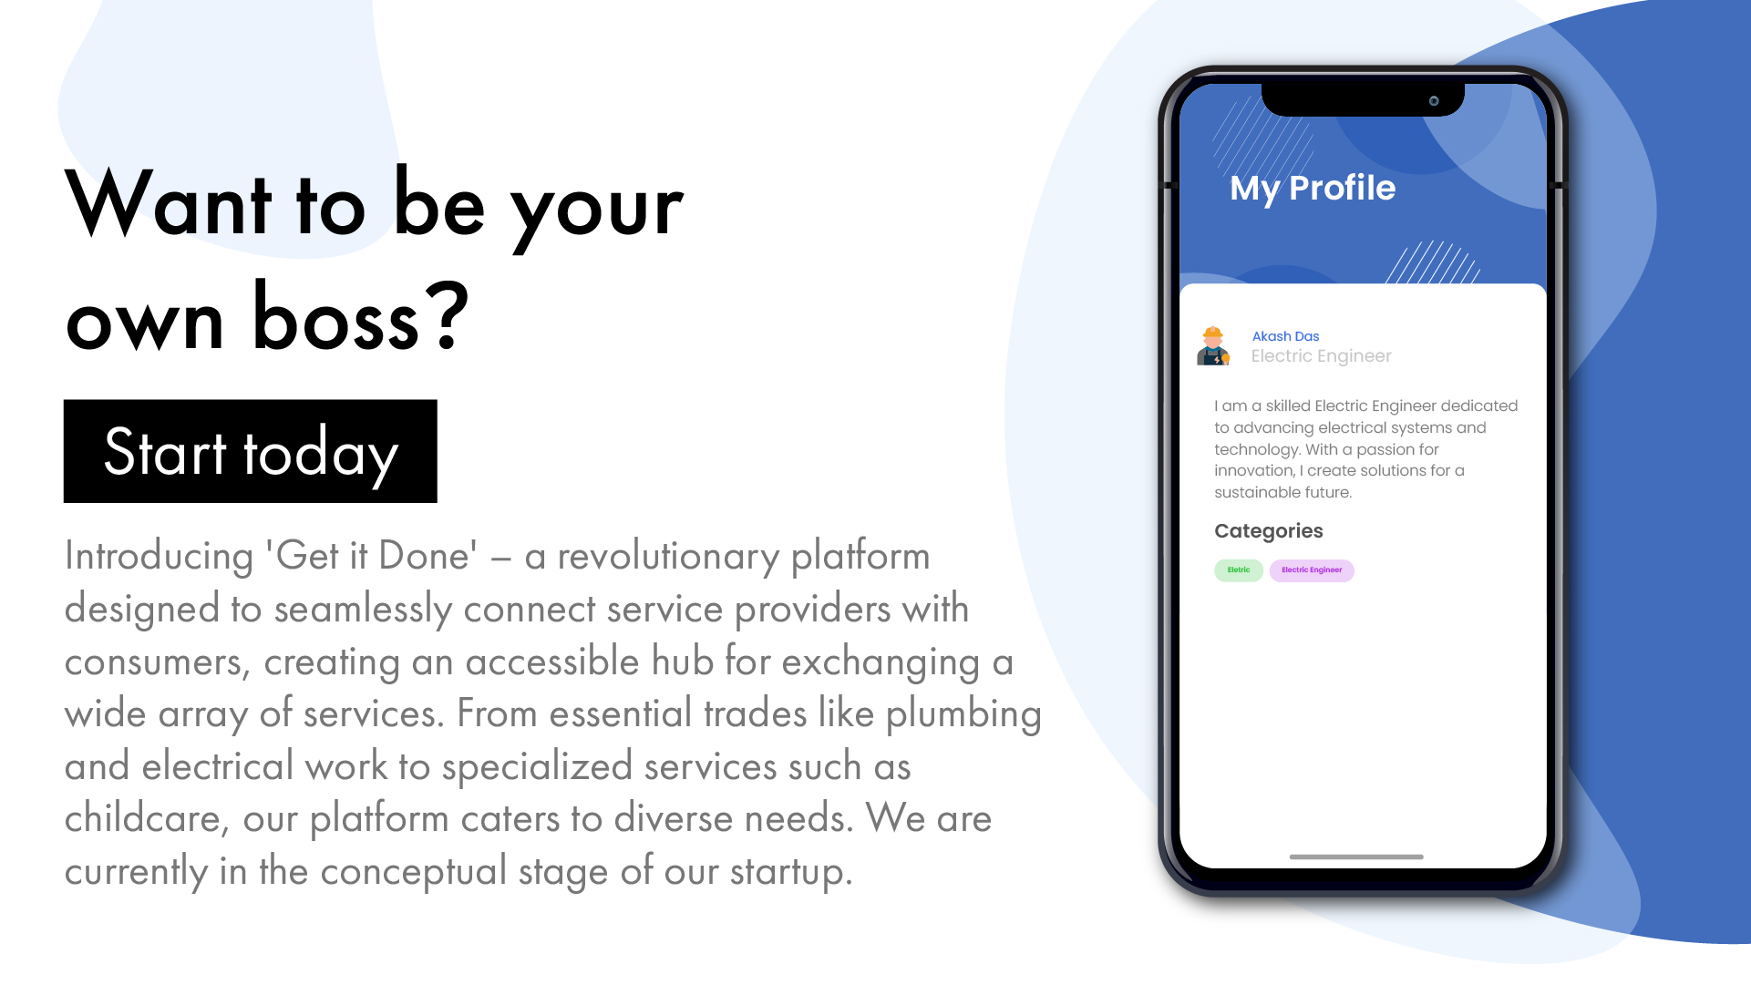

Slide 6
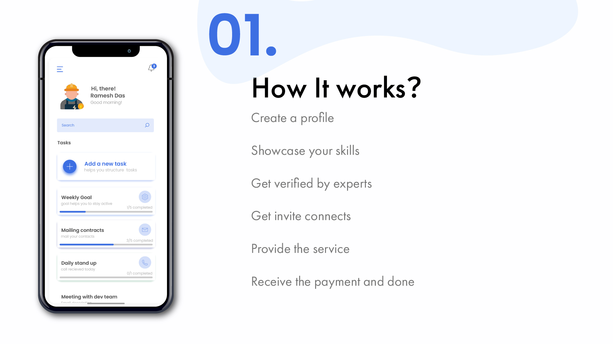

Slide 7
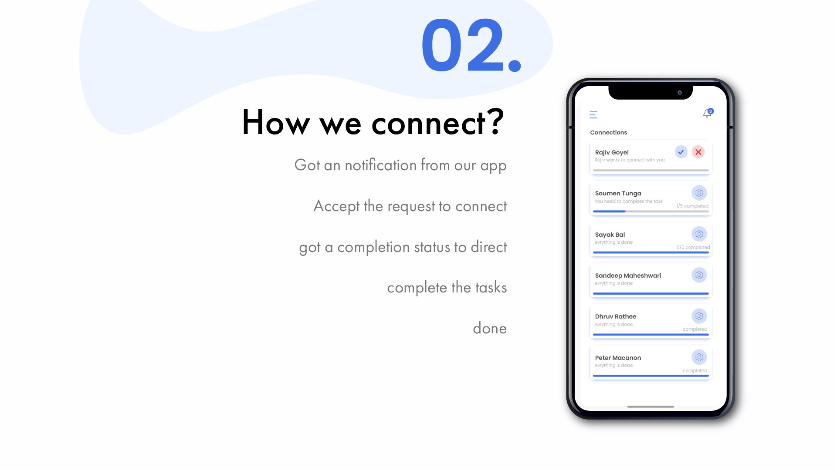

Slide 8
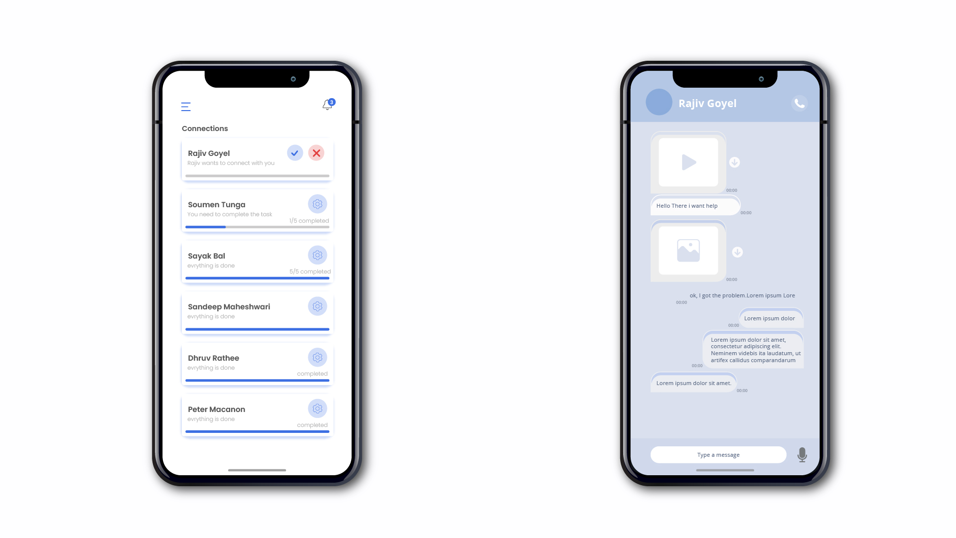

Slide 9

MARKET

Slide 10
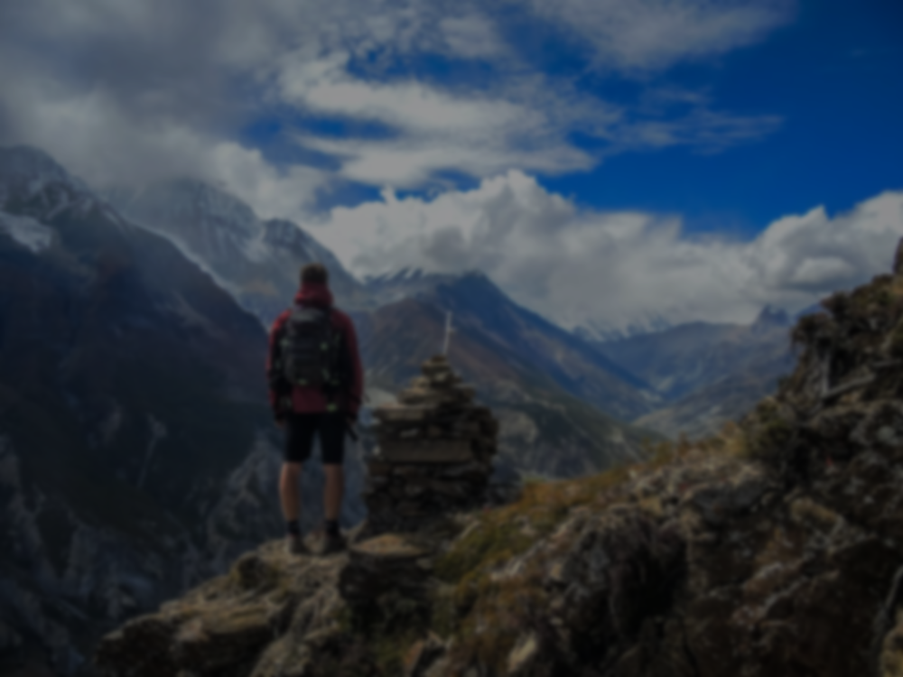
MARKET
Notes:
https://unsplash.com/photos/48nerZQCHgo

Slide 11
We have a very simple business model
customers
App
Service provider
107.5
-7.5%
100

Slide 12
Market size:
Every common man with a smartphone and a need India currently has around 350 million online transacting users across e-commerce, shopping, travel and hospitality, and OTT and the number is set to double by 2030, a new report showed on Wednesday.
Monetary value of this Market:
The services sector is the largest sector in India. Gross Value Added (GVA) at current prices for the services sector is estimated at 96.54 lakh crore INR in 2020-21. The services sector accounts for 53.89% of total India's GVA of 179.15 lakh crore Indian rupees.

Slide 13
Expenses
App Development & design: INR 2 lakh to 3 lakh or more.
Technology Infrastructure: INR 1 lakh to 2 lakhs or more.
Marketing and User Acquisition: INR 1.5 lakhs or more.
Salaries and HR: INR 5 lakhs or more per year.
Office Space and Utilities: INR 1 lakh to 15 lakhs or more per year.
Legal and Registration: INR 50,000 or more.
App Store Fees: INR 25,000 per year.
Customer Support: INR 1 lakh or more per year.
Total: 13 lakh

Slide 14
Estimation For break even and profit
Considering the expenses discussed earlier initial investment is equal to 13,00,000
The average transaction amount is equal to 1000
Expected monthly transaction of 10,000
Total monthly transaction = 1 crore
Expected monthly expenses 6,00,000
Monthly revenue from Commission =7.5 lakh
Monthly profit = monthly revenue - monthly expenses (=7.5 lakh -6,00,000 )
Monthly profit = 1.5 lakh
The time required to recover the initial investment = 13/1*5= 7.6 months approximately 8 months
thus we require approximately 8 months to recover our initial investment and after that each month they will earn around 1.5 lakhs

Slide 15

KEY POINTS

Slide 16

KEY PONTS
Number not displayed
Verified by expert tick
Call recording
Photo
Voice record for disputes
Financial Security
Dismiss for unfair practice
Coupons
Signup bonus
Notes:
https://unsplash.com/photos/TvN54bnuQg8

Slide 17

WHY
US

Slide 18

WHY US
Trust
Assurance
transparency
Range of Choices
convenience
Notes:
https://unsplash.com/photos/GKLIsLZxhj0

